Slide 1
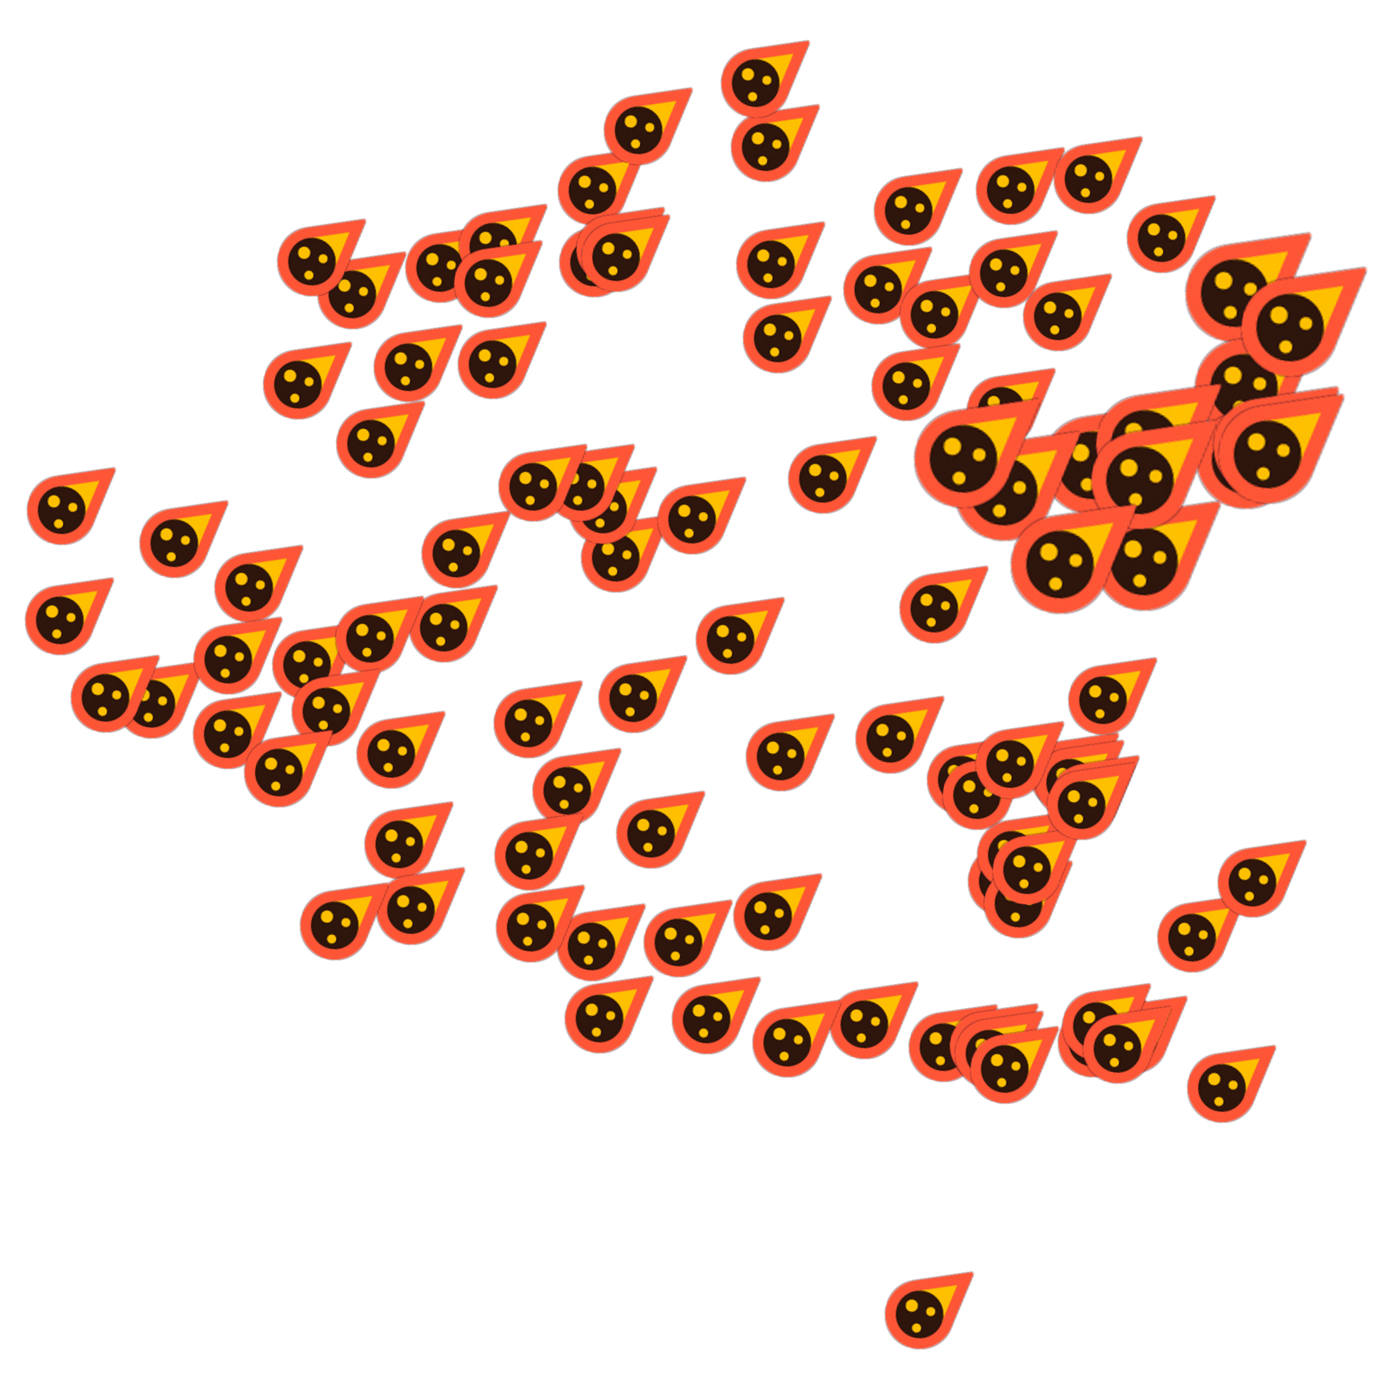

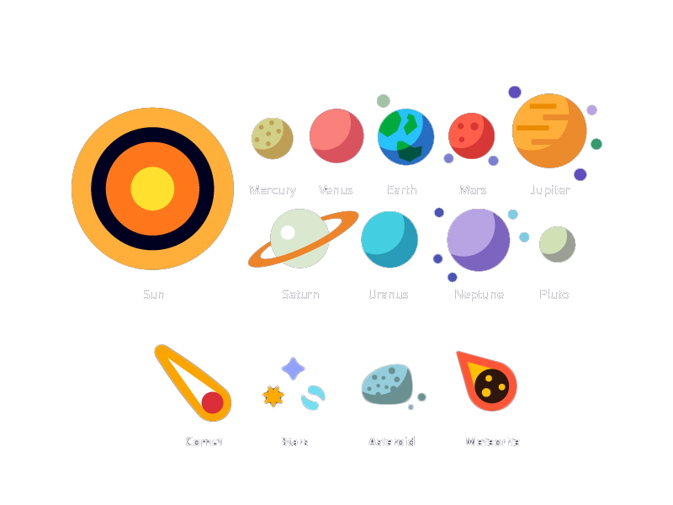

Together Finance
22.10.2023
composition
3 interns that met at the Collabothon
Brainstorming
Our Brainstorming Started at the 1st minute of the Collabothon

Slide 2



The Team
<____>
composition
Brainstorming
3 interns that met at the Collabothon
Our Brainstorming Started at the 1st minute of the Collabothon
The Idea
The Progress
The Product
Commerzbank AG, Anton Mattuschat, GS-TF 13 Operations & Monitoring

Slide 3
The Team
offer a platform for shared family spending
composition
Brainstorming
3 interns that met at the Collabothon
Our Brainstorming Started at the 1st minute of the Collabothon
The Idea
The Progress
The Product
Commerzbank AG, Anton Mattuschat, GS-TF 13 Operations & Monitoring
3

Slide 4
The Idea
Application Logic Development
User Interface and experience
offer a platform for shared family spending
Visual Processing
The Progress
The Product
Commerzbank AG, Anton Mattuschat, GS-TF 13 Operations & Monitoring
4

Slide 5
The Progress
offer a platform for shared family spending
Application Logic Development
trough teamwork,
we achieve goals
User Interface and experience
Visual Processing
Commerzbank AG, Anton Mattuschat, GS-TF 13 Operations & Monitoring
5
Notes:
We split the Work in the categories
we worked in constant exchange with each other to achieve the best possible result

Slide 6
The Product
trough teamwork,
we achieve goals
Application Logic Development
User Interface and experience
Visual Processing
Commerzbank AG, Anton Mattuschat, GS-TF 13 Operations & Monitoring
6

Slide 7
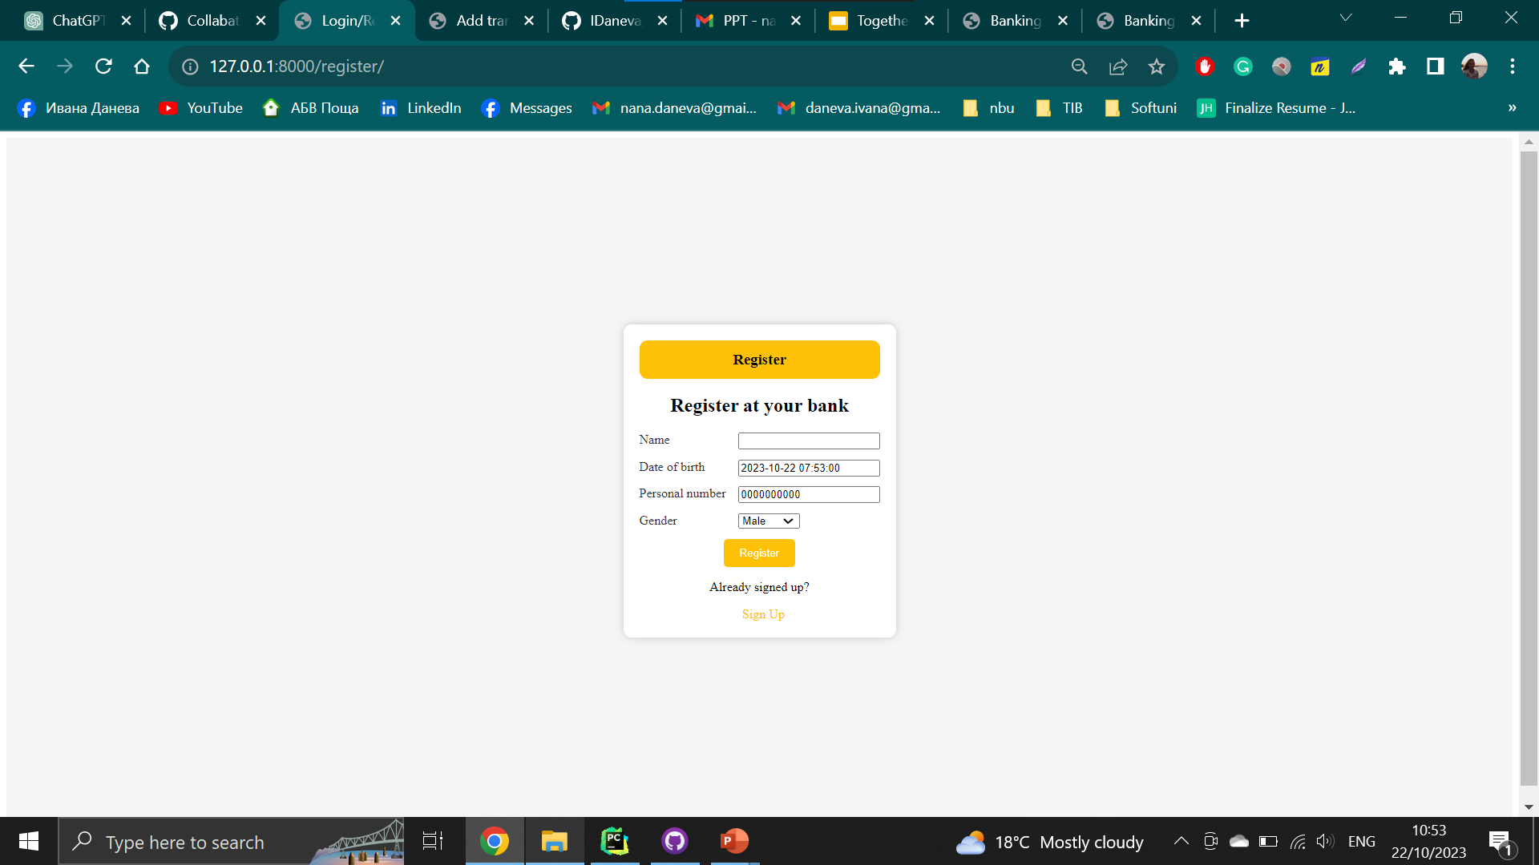
Live Presentation
trough teamwork,
we achieve goals

